Slide 1
International Standard Atmosphere (ISA)
Temperature Distribution in the Standard Atmosphere

Slide 2
International Standard Atmosphere (ISA)
Isothermal Layer

Slide 3
International Standard Atmosphere (ISA)
Gradient Layer

Slide 4
International Standard Atmosphere (ISA)
Problem: Calculate the standard temperature values of T, p, and ρ at a geopotential altitude of 14 km.
Hint : Use p₁= 1.01*10⁵ N/m² ; ρ ₁= 1.23 Kg/m³ ; a= -0.0065 K/Km
g₀= 9.8 m/s² ; R = 287 J/Kg-K.
Solution :
p = 2.26 *10⁴ N/m² ; ρ = 0.367 Kg/m³ (At 11 Km)
p = 1.41 *10⁴ N/m² ; ρ = 0.23 Kg/m³ (At 14 Km)

Slide 5
International Standard Atmosphere (ISA)
Pressure Altitude
Temperature Altitude
Density Altitude

Slide 6
Bernoulli’s Equation
Euler’s Equation:
Bernoulli’s Equation:
Assumptions:
Flow is inviscid and incompressible

Slide 7
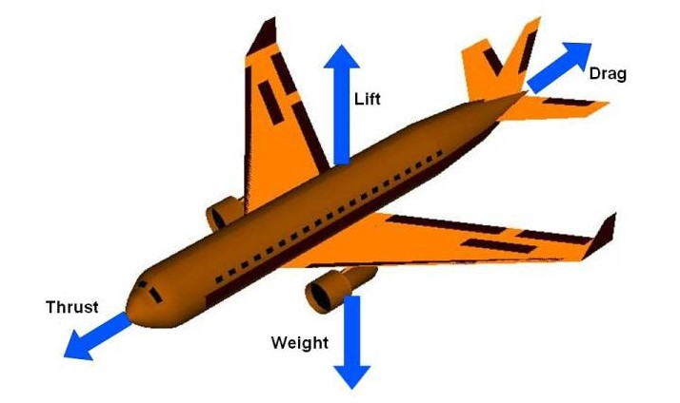
Forces and Moments on an Airplane
Four Forces acting on an Airplane

Slide 8
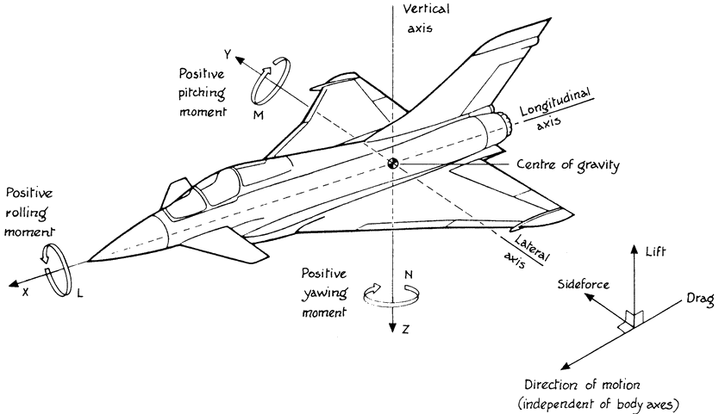
Forces and Moments on an Airplane
Four Forces acting on an Airplane

Slide 9
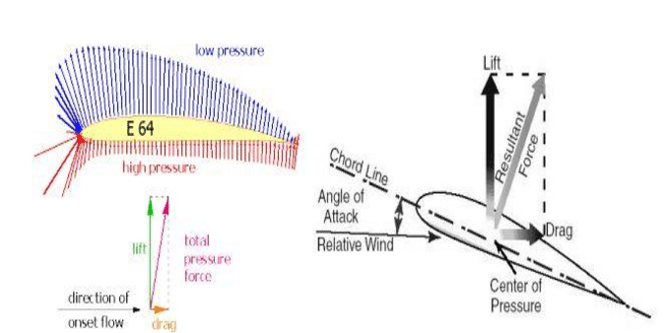
Lift Generation Principle:

Slide 10
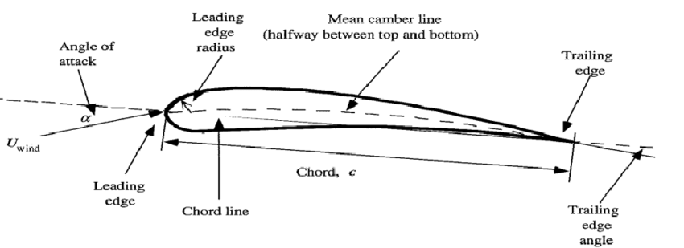
Aerofoil:
An aerofoil is a streamlined body capable of generating significantly more lift than drag.

Slide 11
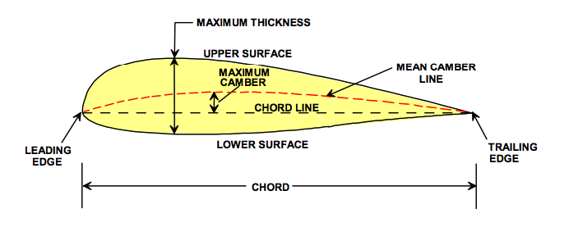
Mean camber line: The locus of points halfway between the upper and lower surfaces as measured perpendicular to the mean camber line.
Leading & trailing edges: The most forward and rearward points of the mean camber line.
Chord line: The straight line connecting the leading and trailing edges
Chord C: The distance from the leading to trailing edge measured along the chord line.
Camber: The maximum distance between the mean camber line and the chord line.

Slide 12
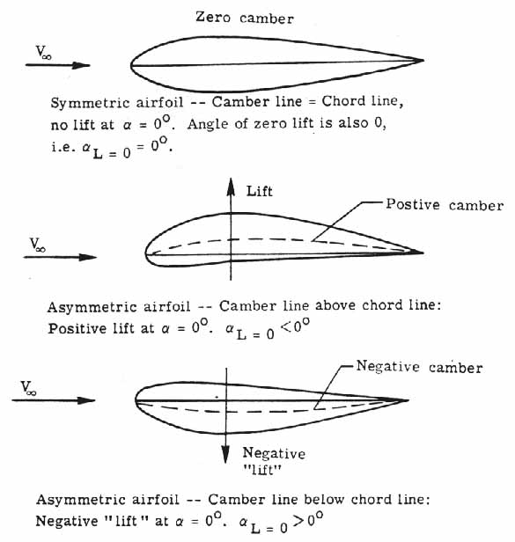
TYPES OF AEROFOILS
The symmetrical aerofoil is distinguished by having identical upper and lower surfaces. The mean camber line and chord line are the same on a symmetrical aerofoil
The Asymmetric aerofoil has different upper and lower surfaces, with a greater curvature of the aerofoil above the chord line than below. The mean camber line and chord line are different.

Slide 13
SERIES
NACA (National Advisory Committee for Aeronautics) or NASA (National Aeronautics and Space administration) identified different airfoil shapes with a logical numbering system.
NACA Airfoil Series
1- NACA 4-digit series
2- NACA 5-digit series
3- NACA 6- series
4- NACA 7- series
5- NACA 8- series

Slide 14
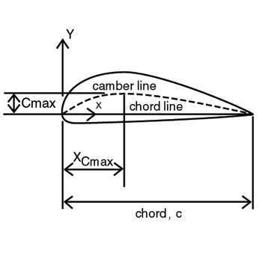
NACA 4 DIGIT SERIES
The NACA four-digit wing sections define the profile by
First digit describing maximum camber as percentage of the chord.
Second digit describing the distance of maximum camber from the aerofoil leading edge in tens of percent of the chord.
Last two digits describing maximum thickness of the aerofoil as percent of the chord.
Example: NACA 2412

Slide 15
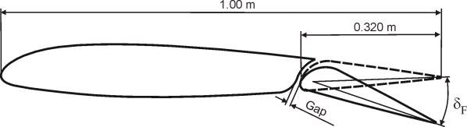
NACA 5 DIGIT SERIES
The NACA five-digit series describes more complex aerofoil shapes.
The first digit when multiplied by 0.15, gives the designed coefficient of lift
The second and third digit when multiplied by 2 give p, the distance of maximum camber from leading edge as percent chord
Fourth and fifth gives the maximum thickness of aerofoil as percent of chord
Example: NACA 23012

Slide 16
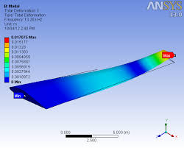
NACA 6 SERIES
The aerofoil is described using six digits in the following sequence:
The number "6" indicating the series.
One digit describing the distance of the minimum pressure area in tens of percent of chord.
The subscript digit gives the range of lift coefficient in tenths above and below the design lift coefficient in which favourable pressure gradients exist on both surfaces
A hyphen.
One digit describing the design lift coefficient in tenths.
Two digits describing the maximum thickness as percent of chord.
For example, the NACA 61₂-315

Slide 17
NACA 7 & 8 SERIES
NACA 7 SERIES:The aerofoil is described by seven digits in the following sequence:
The number "7" indicating the series.
One digit describing the distance of the minimum pressure area on the upper surface in tens of percent of chord.
One digit describing the distance of the minimum pressure area on the lower surface in tens of percent of chord.
One letter referring to a standard profile from the earlier NACA series.
One digit describing the lift coefficient in tenths.
Two digits describing the maximum thickness as percent of chord.
"a=" followed by a decimal number describing the fraction of chord over which laminar flow is maintained. a=1 is the default if no value is given.
For example, the NACA 712A315
NACA 8 SERIES: The numbering is identical to the 7-series aerofoils except that the sequence begins with an "8" to identify the series.

Slide 18
Aircraft Maneuvers:
Aircraft maneuvers can be categorized as basic flight maneuvers, aerobatic maneuvers, or air combat maneuvers:
Basic flight Maneuvers:
These maneuvers control an airplane through the six motions of flight:
Straight and level flight: The first fundamental maneuver
Turns
Climbs: Involves increasing the aircraft's altitude
Descents
Aerobatic Maneuvers:
These include:
High-rate turns, where pilots rapidly change direction while maintaining altitude
Rapid pull-ups, where the aircraft swiftly ascends
Spins, loops, and inverted flights

Slide 19
Aircraft Maneuvers:
Air Combat Maneuvers:
These maneuvers can be used by attackers or defenders to gain an advantage
Lag pursuit or yo-yo: Adds distance when the attacker may overshoot the target
Low yo-yo: Does the opposite when the attacker is flying too slow
Scissors: Attempts to drive the attacker in front of the defender
Defensive spiral: Allows a defender to disengage from an attacker

Slide 20
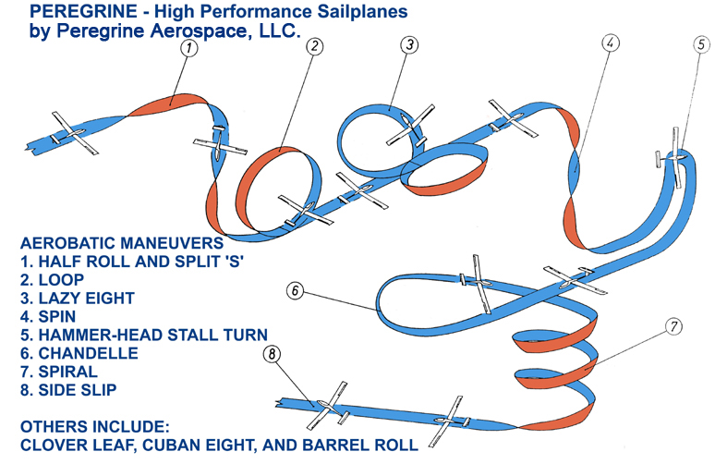

Slide 21
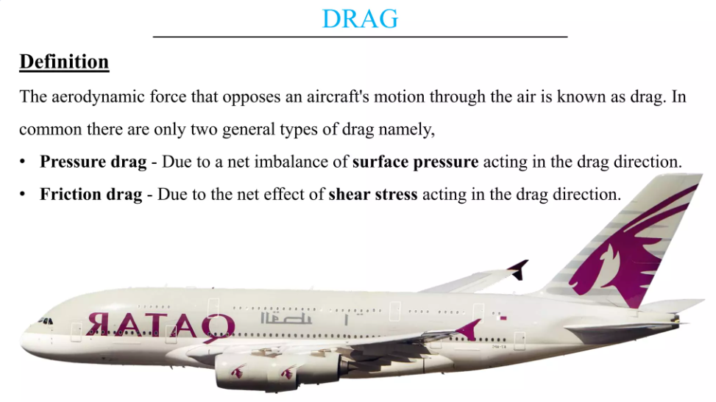
Drag Polar:

Slide 22
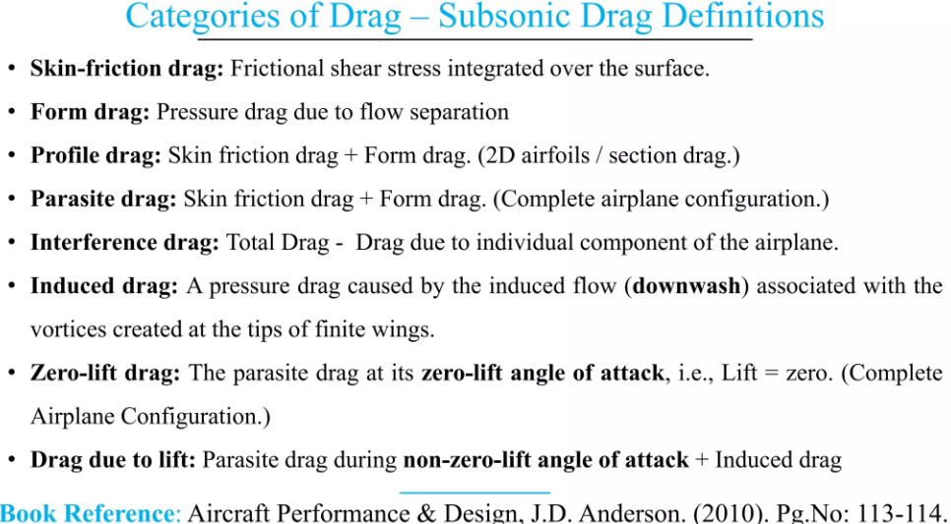
Drag Polar:

Slide 23
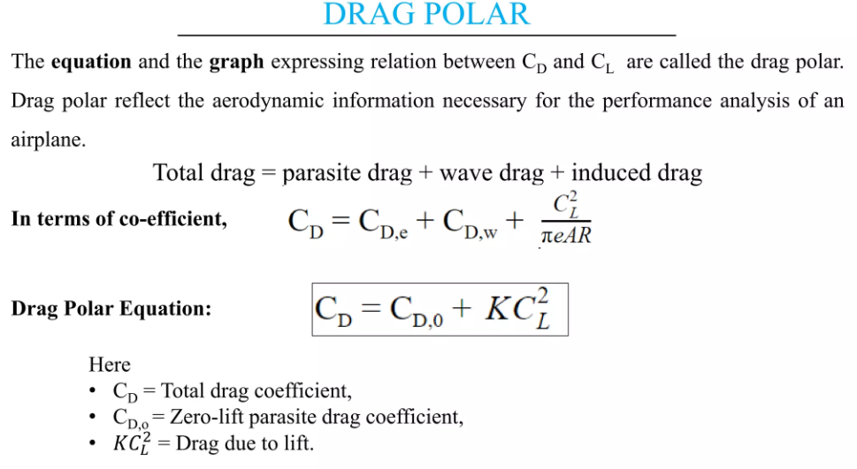
Drag Polar:

Slide 24
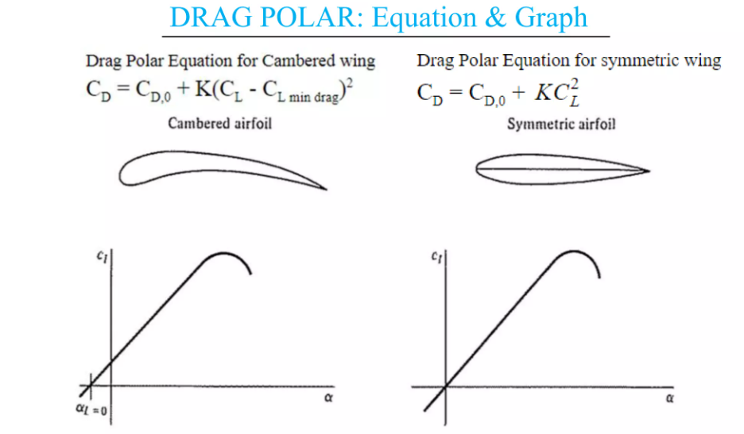
Drag Polar:

Slide 25
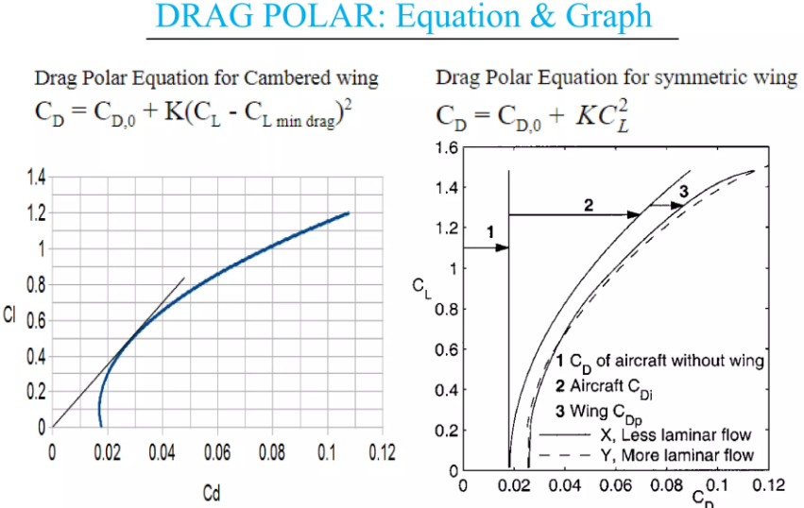
Drag Polar:

Slide 26
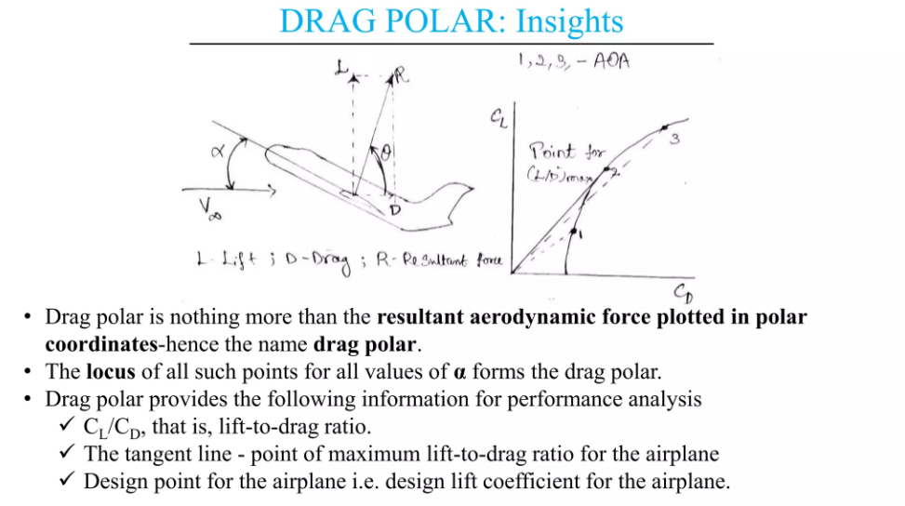
Drag Polar:

Slide 27
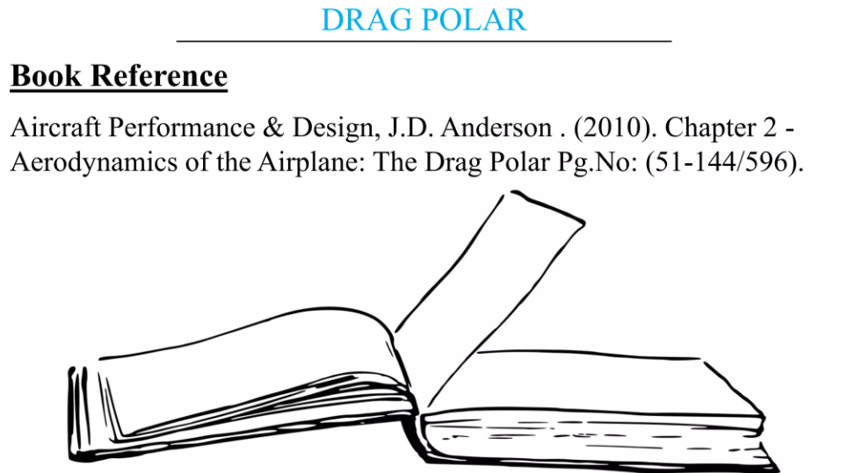
Drag Polar:

Slide 28
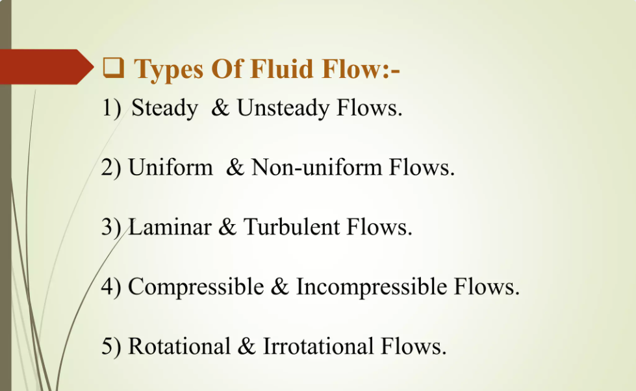
Classification of Fluid Flows:

Slide 29
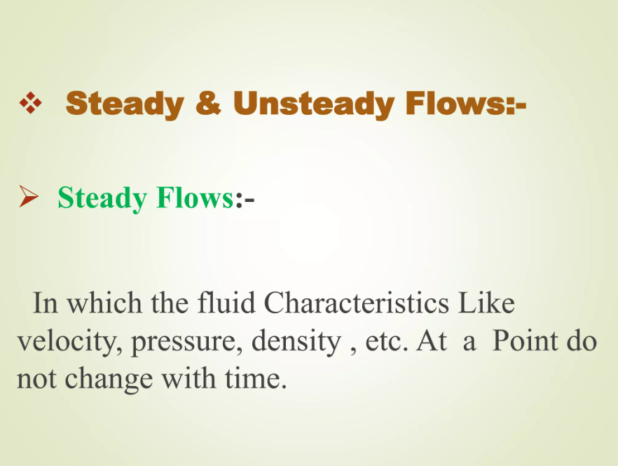
Classification of Fluid Flows:

Slide 30
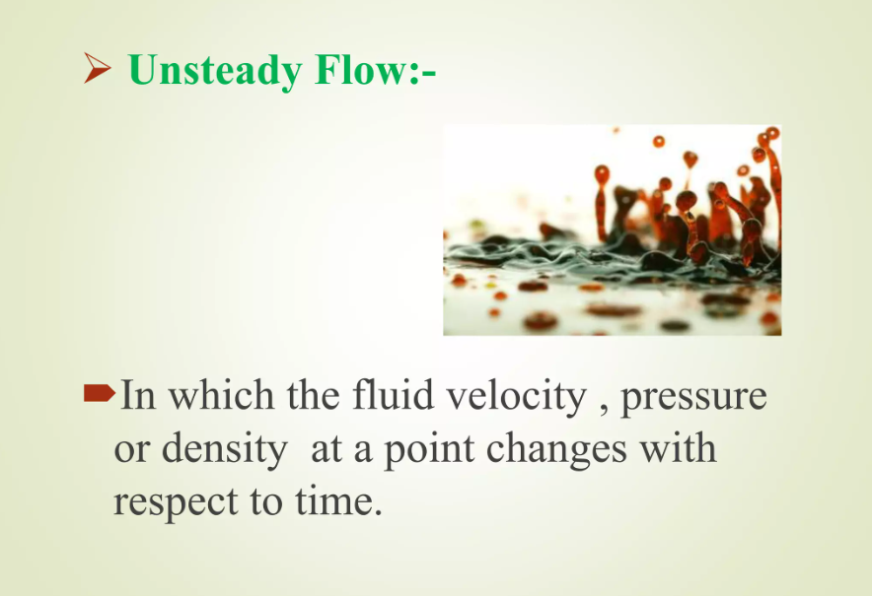
Classification of Fluid Flows:

Slide 31
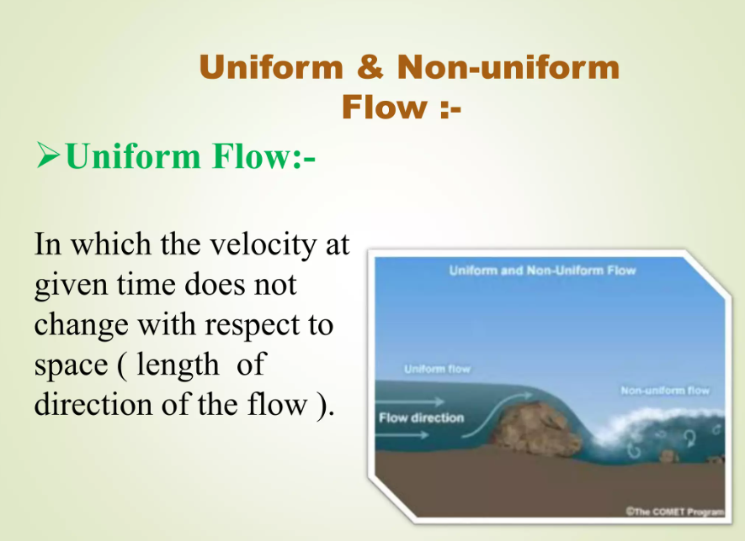
Classification of Fluid Flows:

Slide 32
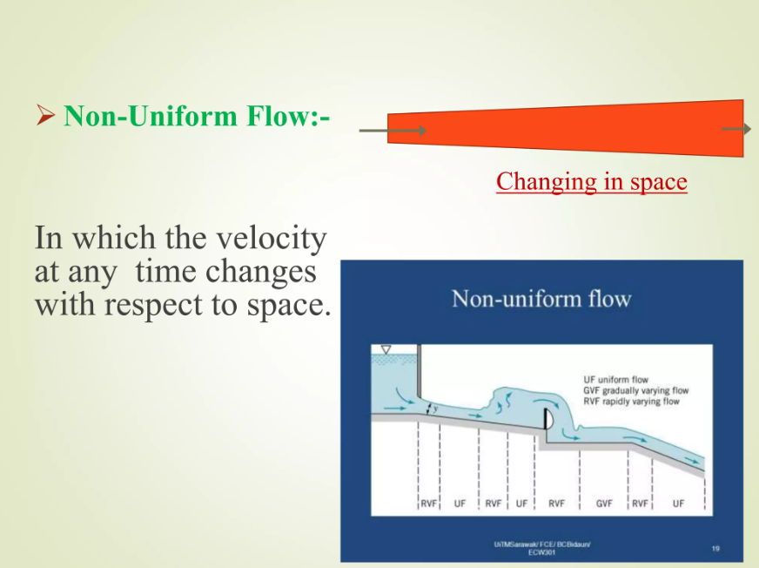
Classification of Fluid Flows:

Slide 33
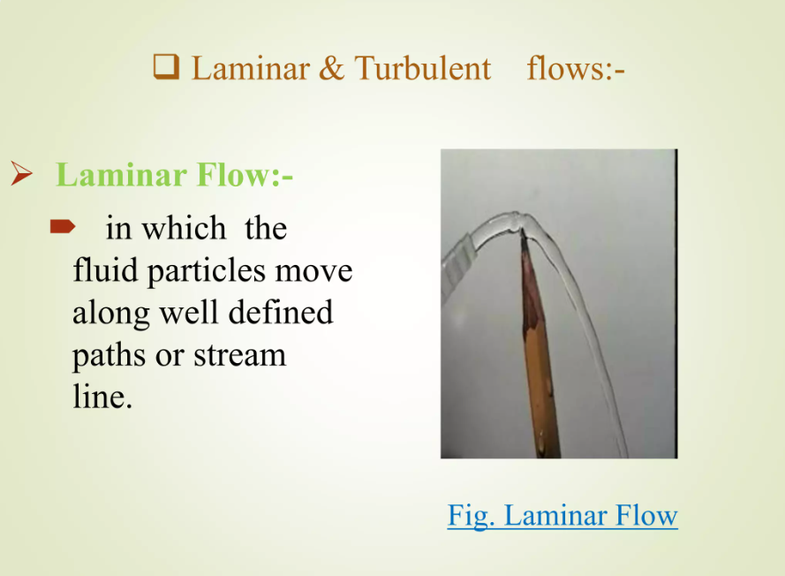
Classification of Fluid Flows:

Slide 34
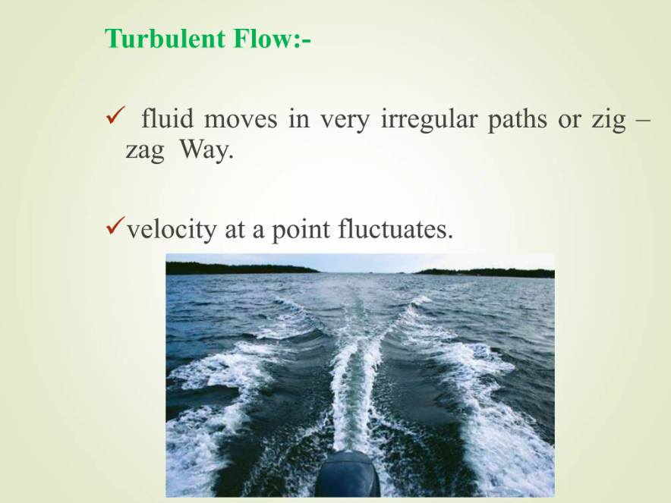
Classification of Fluid Flows:

Slide 35
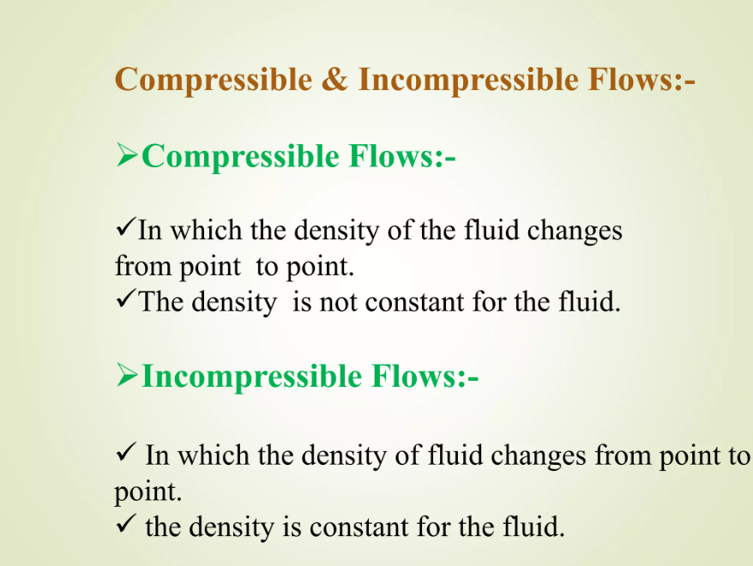
Classification of Fluid Flows:

Slide 36
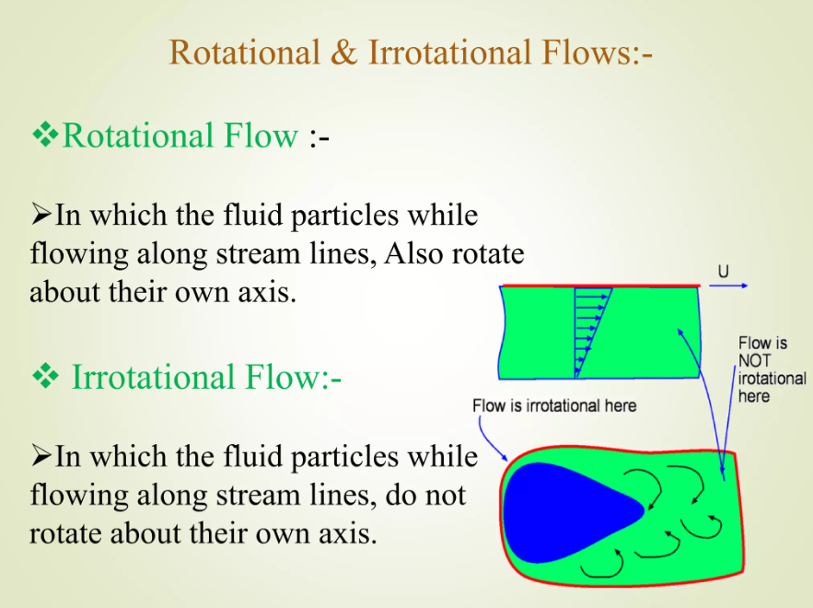
Classification of Fluid Flows:

Slide 37
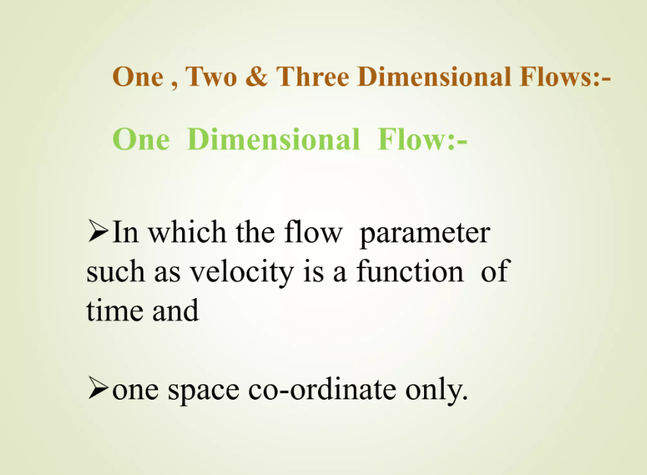
Classification of Fluid Flows:

Slide 38
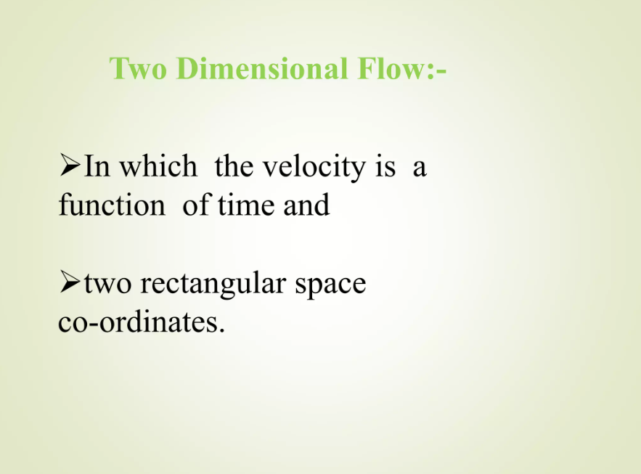
Classification of Fluid Flows:

Slide 39
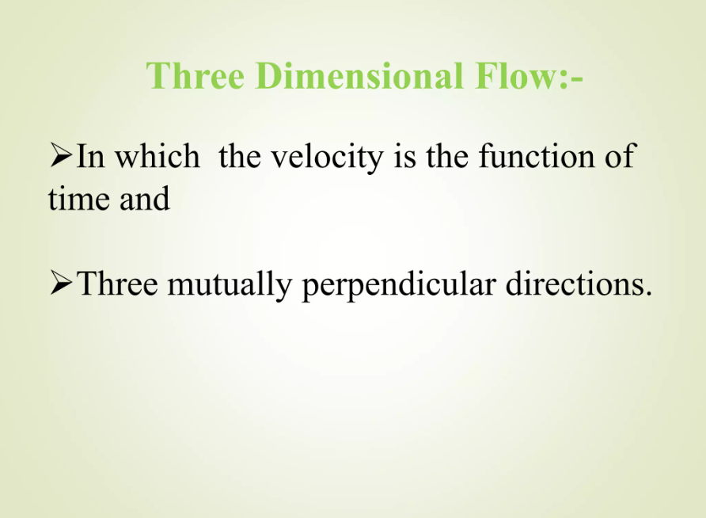
Classification of Fluid Flows:

Slide 40
Classification of Fluid Flows:
Based on Mach Number (M):
Subsonic Flow (up to M=0.8)
Transonic Flow( M = 0.9 to 1.2)
Sonic Flow (M=1)
Supersonic Flow (M= 1.2 to 5)
Hypersonic Flow (M is above 5)

